Slide 1


HDFS Log File Anomaly Detection
Group 6
Akshita Chooramani
Afreen Shakeel

Slide 2
Topic
Pre-Processing of Data
Exploratory Data Model
Tentative Model Choice

Slide 3
Pre-Processing of Data

Slide 4
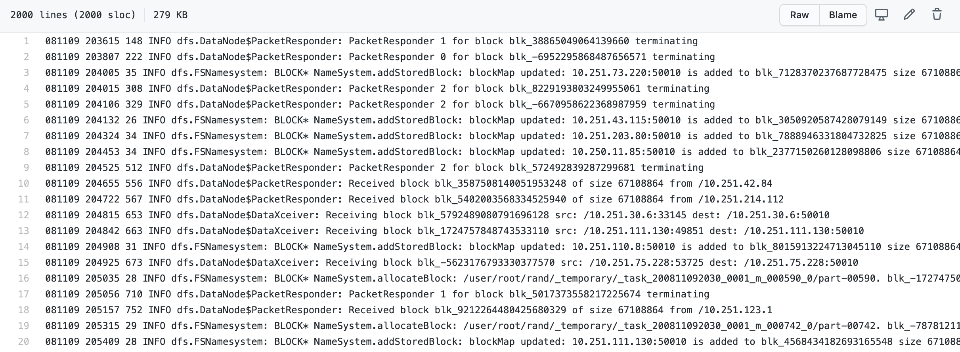
Raw data

Slide 5
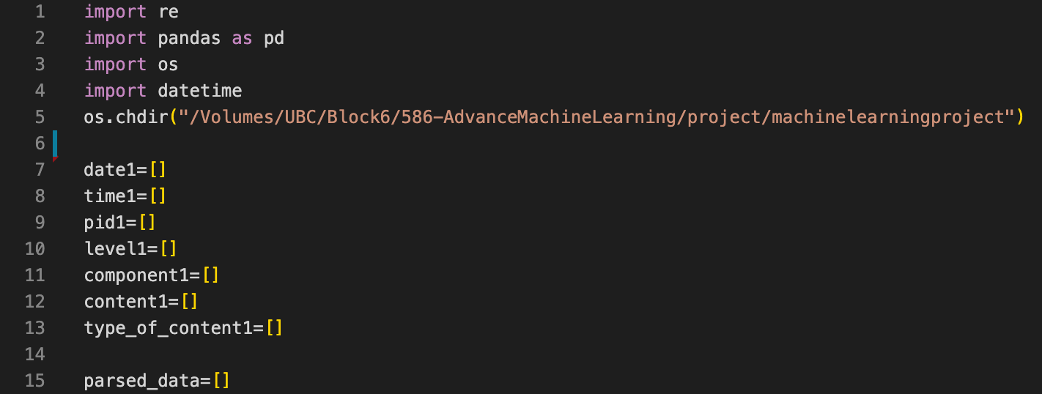
Cleaning of raw data

Slide 6
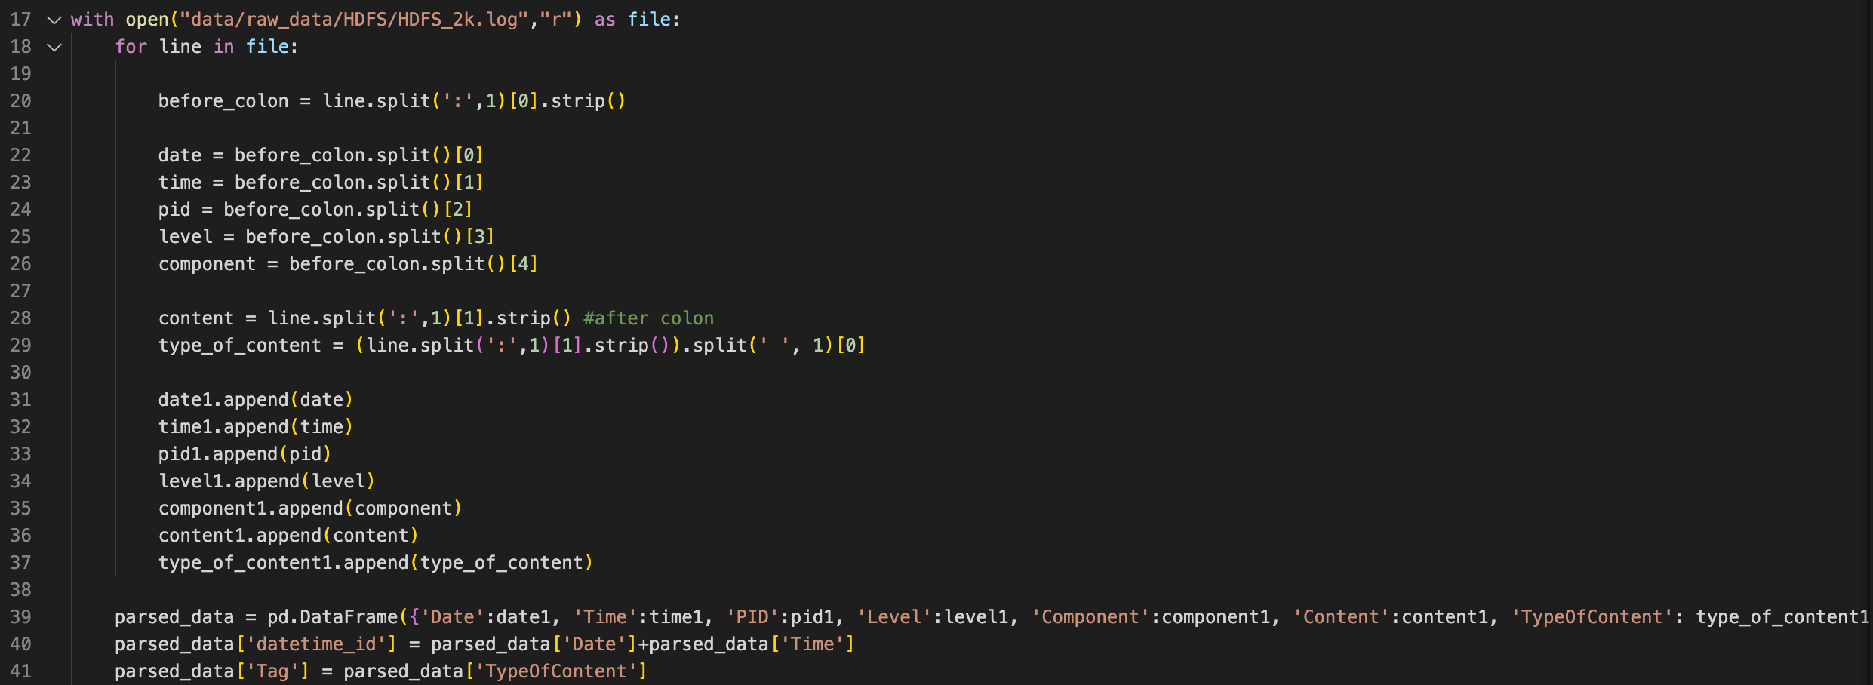
Creating a data frame

Slide 7
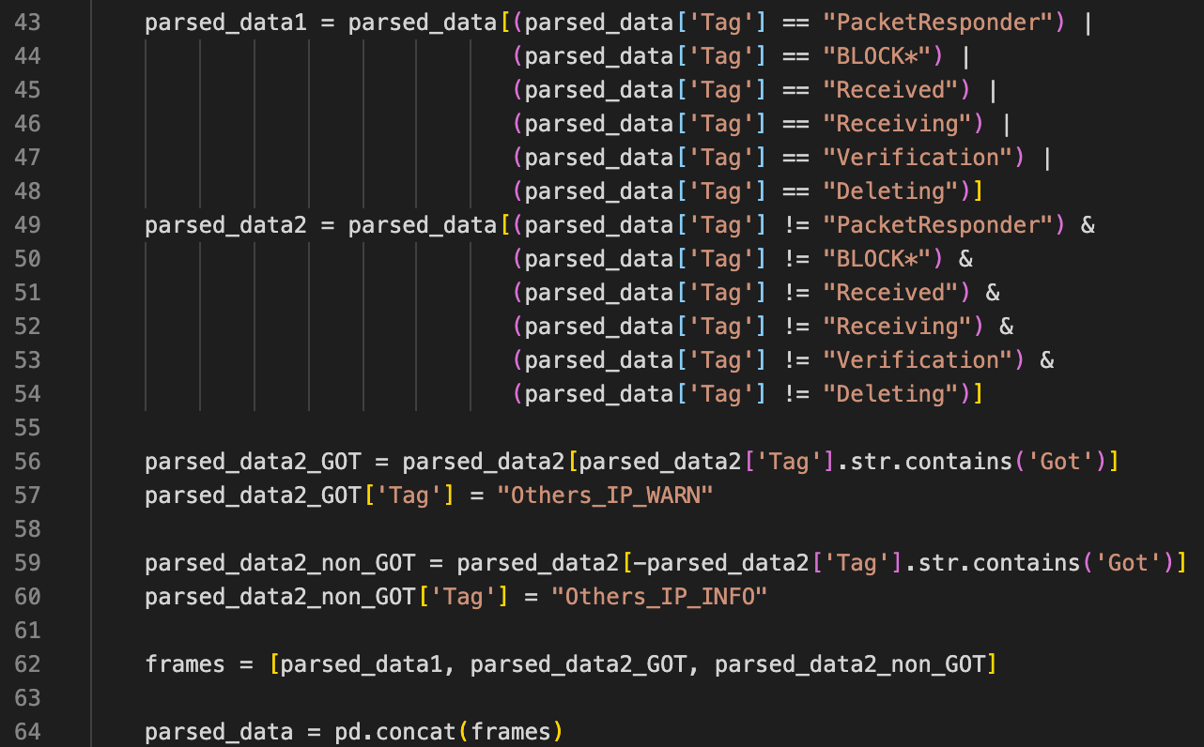
Wrangling to get TAG

Slide 8
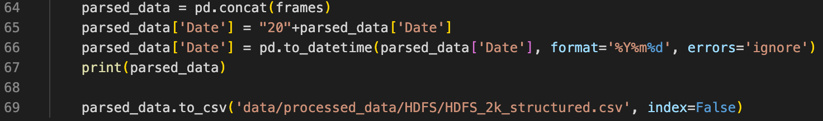
Wrangling to fix date

Slide 9
Exploratory Data Analysis

Slide 10
Five steps
Describe the data set
Load the data set
Explore the data set
Initial thoughts
Data Visualization

Slide 11
Describe the data set
The data set we will be visualizing is the HDFS logfile data set. We have 9 columns in this dataset after structuring it in a dataframe
Date: Date of the record of the log row entry
Time: Time of the record of the log row entry
PID: Process ID
Level: Information like a log entry is "Warn" or "Info”

Slide 12
Describe the data set
Component: It contains information like DNS Packet receiver or block etc
Content: It contains elaborated details of the component
TypeOfContent: It is details about content in a cleaner format
datetime_id: It is unique row id
Tag: Based on the data, we have added some tags for easier calculation

Slide 13
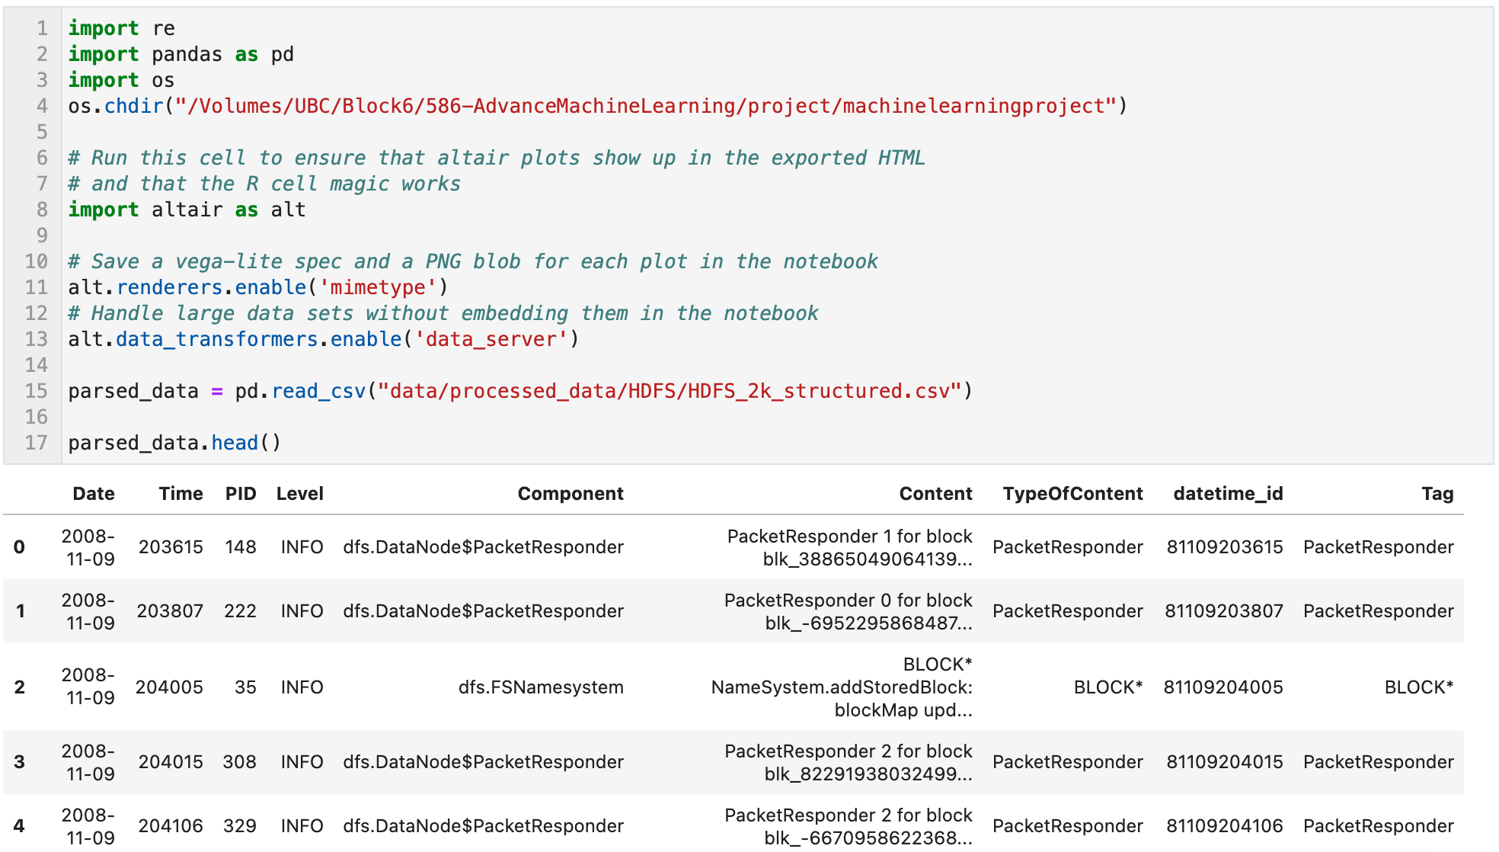
Load the data set

Slide 14
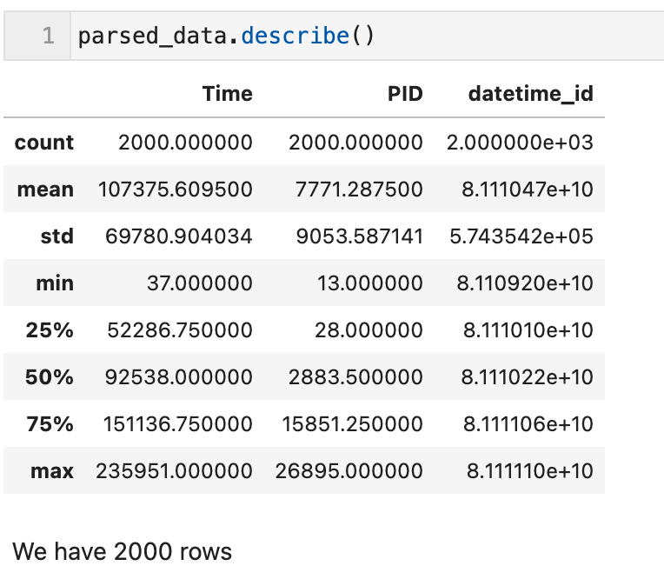
Explore the dataset

Slide 15
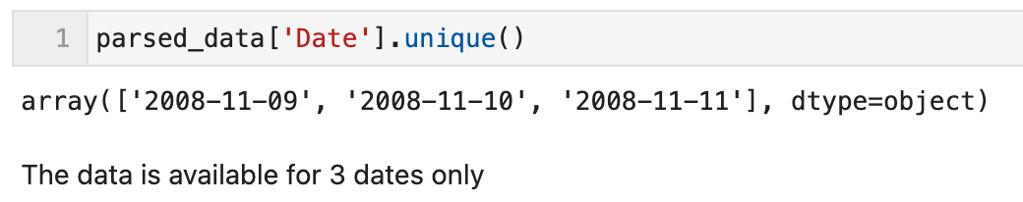
Explore the dataset

Slide 16
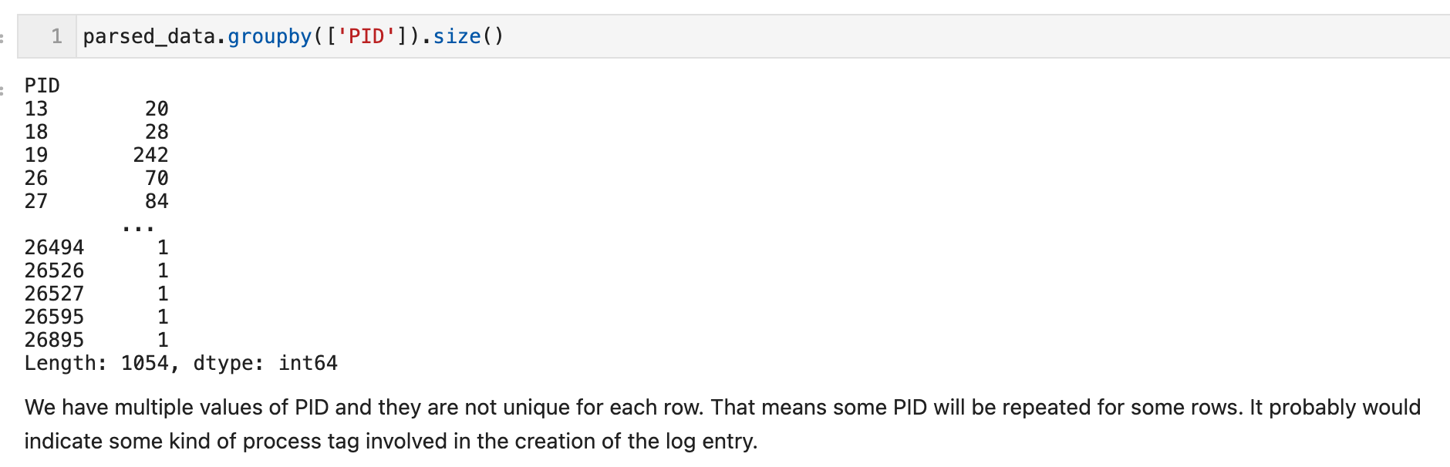
Explore the dataset

Slide 17
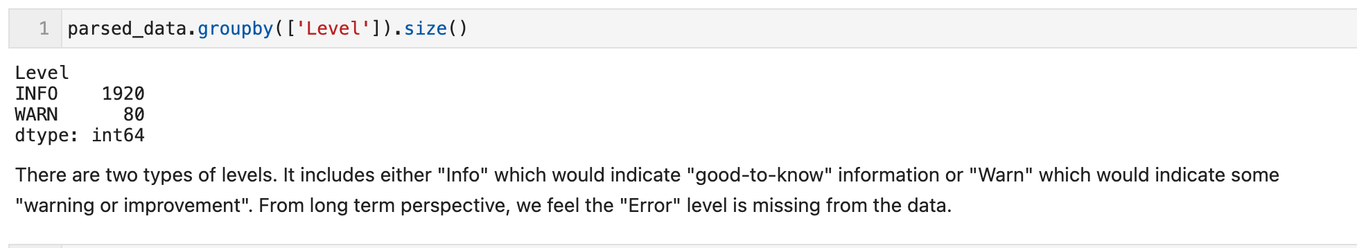
Explore the dataset

Slide 18
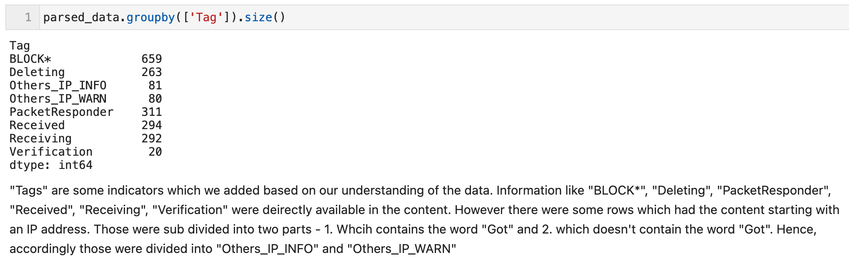
Explore the dataset

Slide 19
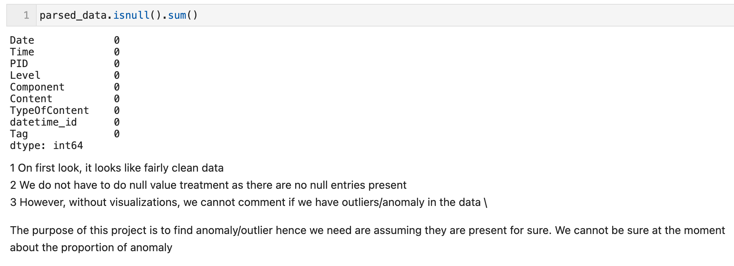
Initial thoughts

Slide 20
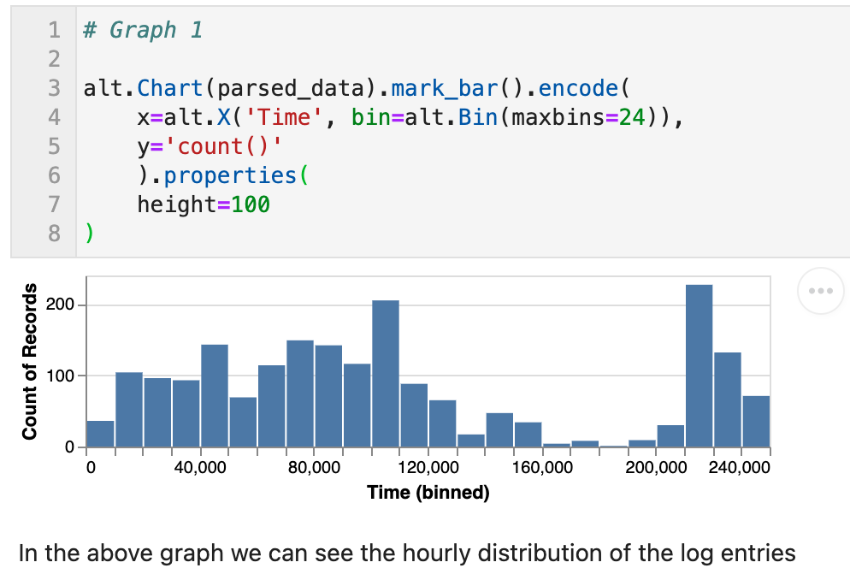
Visualization

Slide 21
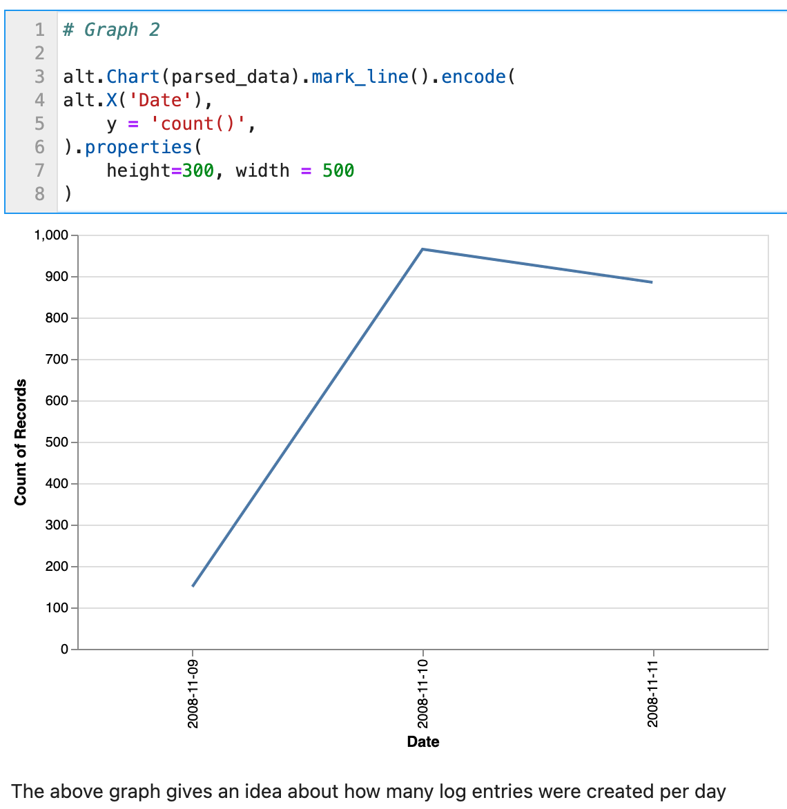
Visualization

Slide 22
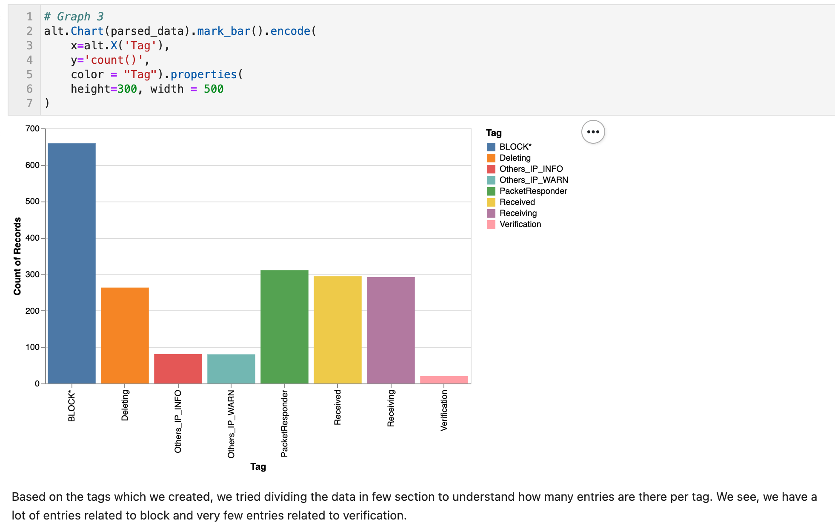
Visualization

Slide 23
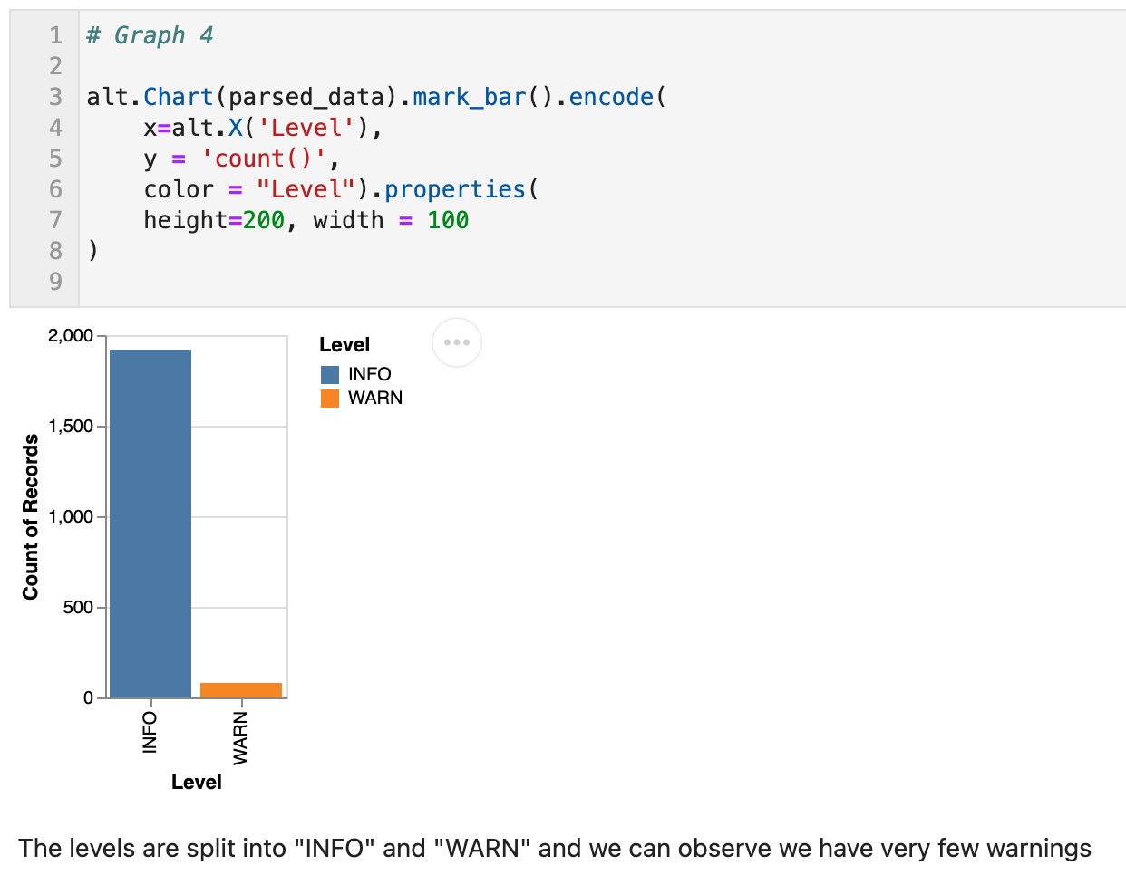
Visualization

Slide 24
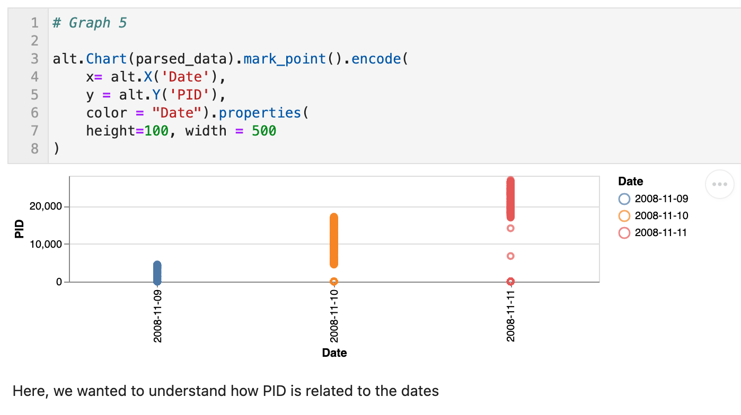
Visualization

Slide 25
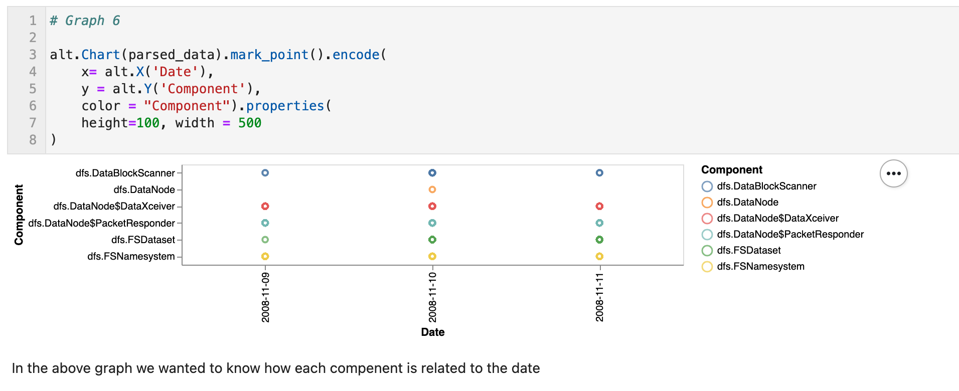
Visualization

Slide 26
Tentative Model Choice

Slide 27
Possible models that will detect anomaly
The models which we plan to use are as follows
LSCP: LSCP: Locally Selective Combination of Parallel Outlier Ensembles
Random Forest
PCA: Principal Component Analysis (the sum of weighted projected distances to the eigenvector hyperplanes)
kNN: k Nearest Neighbours (use the distance to the kth nearest neighbour)
Weighted Average: Simple combination by averaging the scores with detector weights

Slide 28
Thank you

